Slide 1
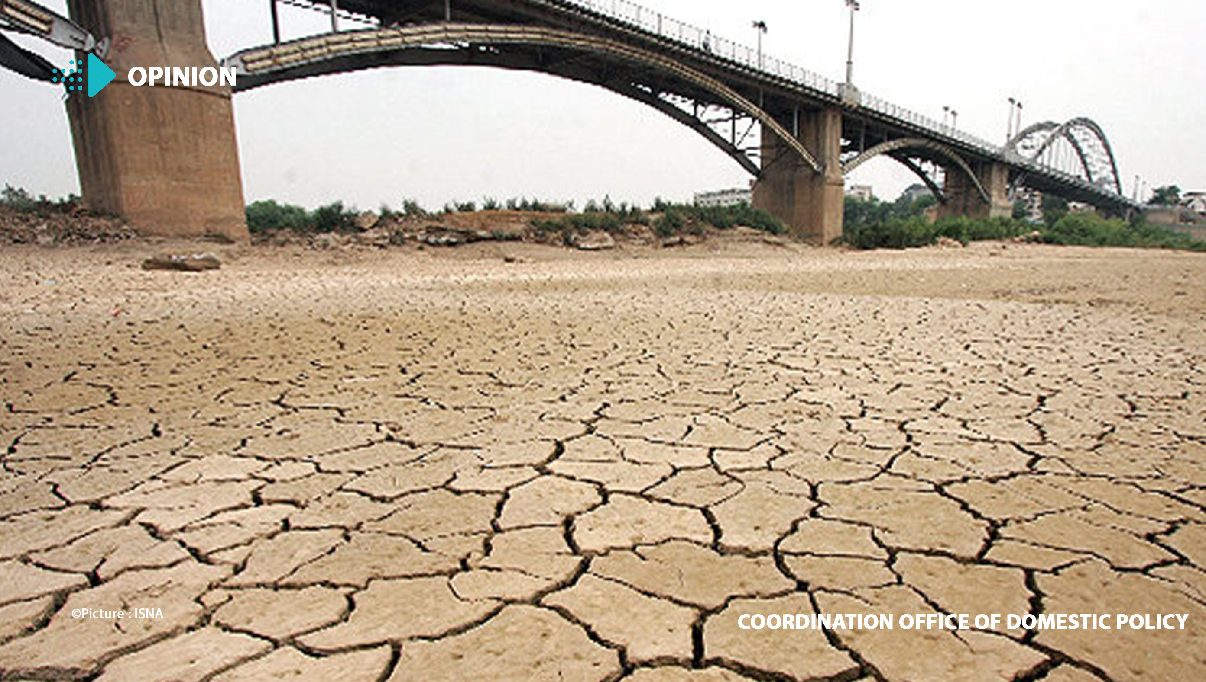
WATER SHORTAGE IN IRAN
BY NATHANAËL AND TOM

Slide 2
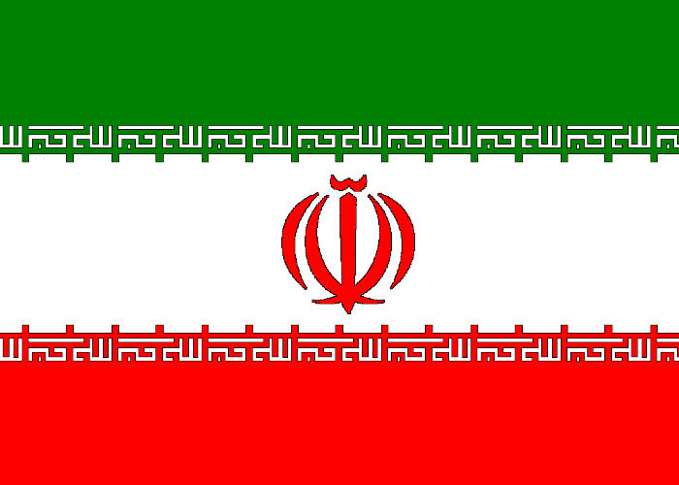
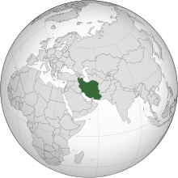
Additional infos:
Population: 84 million people
Area: 1 648 195 km²
Capital city: Tehran
Governer: Ali Khamenei
Language: Persian

Slide 3

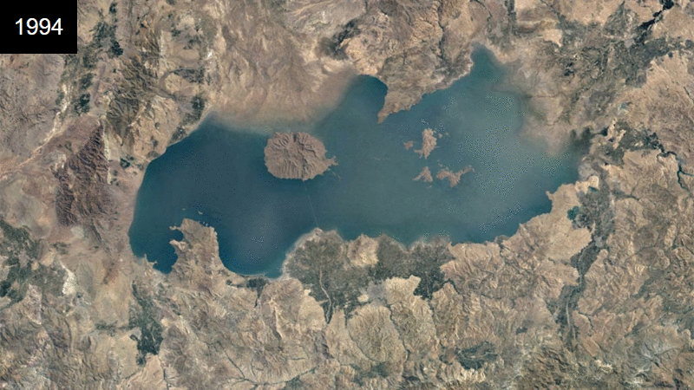
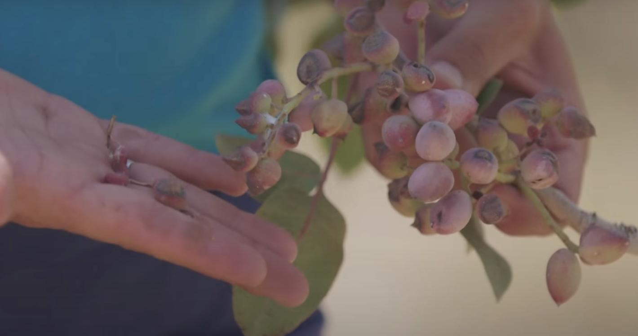
LOCATION : Nothern part of Iran
DRIED PISTACHIOS

Slide 4
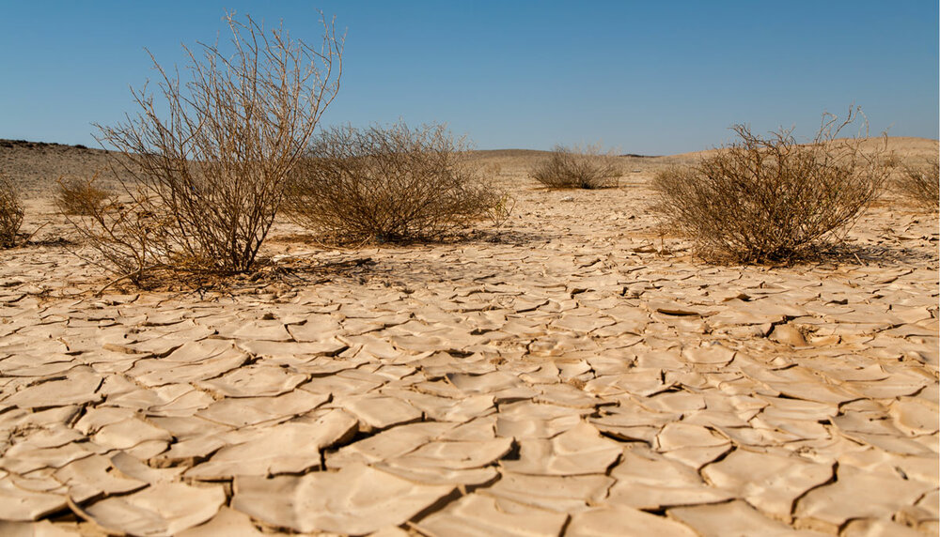
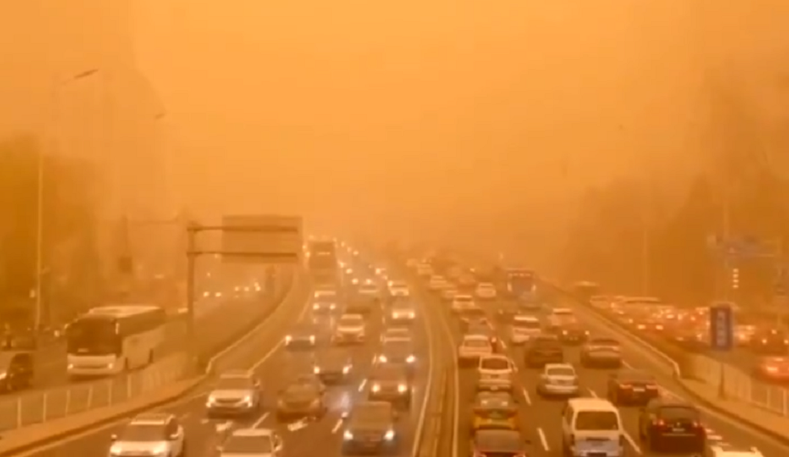
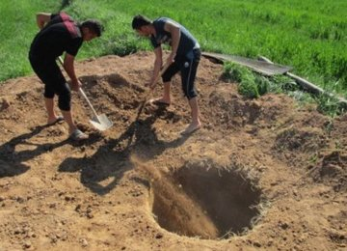
Illegal well being dug

Slide 5

THANK YOU FOR YOUR ATTENTION !!

